Slide 1
인공지능 프로젝트 6조 최종 발표 - UnVeilify: Personalized Mask Remover -
김민지 (2020312915)
나호현 (2018310448)
유재민 (2018312113)
이승민 (2021314284)
이현민 (2020312076)
진형주 (2021312754)

Slide 2
Contents
Introduction
Method
Experiment
Discussion
Conclusion

Slide 3
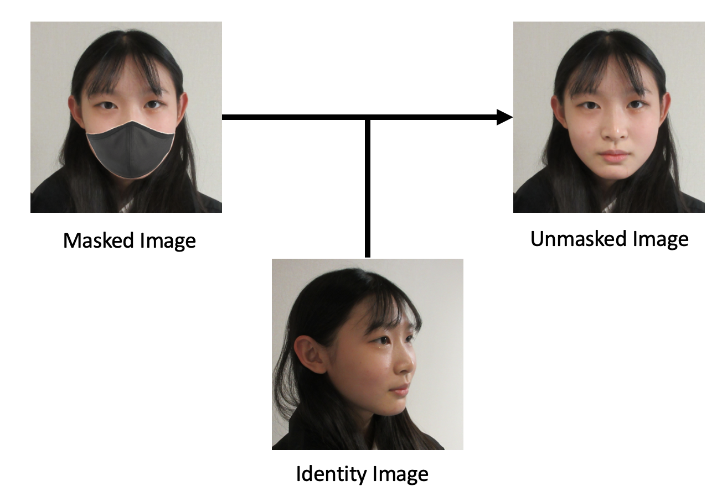
Introduction
Personalized image generation is highly desirable.
Our goal is to remove facial masks in images while preserving identity.
We expect two inputs from the user:
1) A masked image
2) An identity image

Slide 4
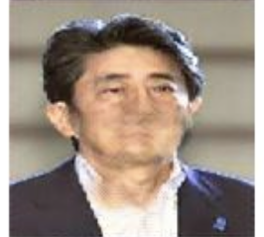
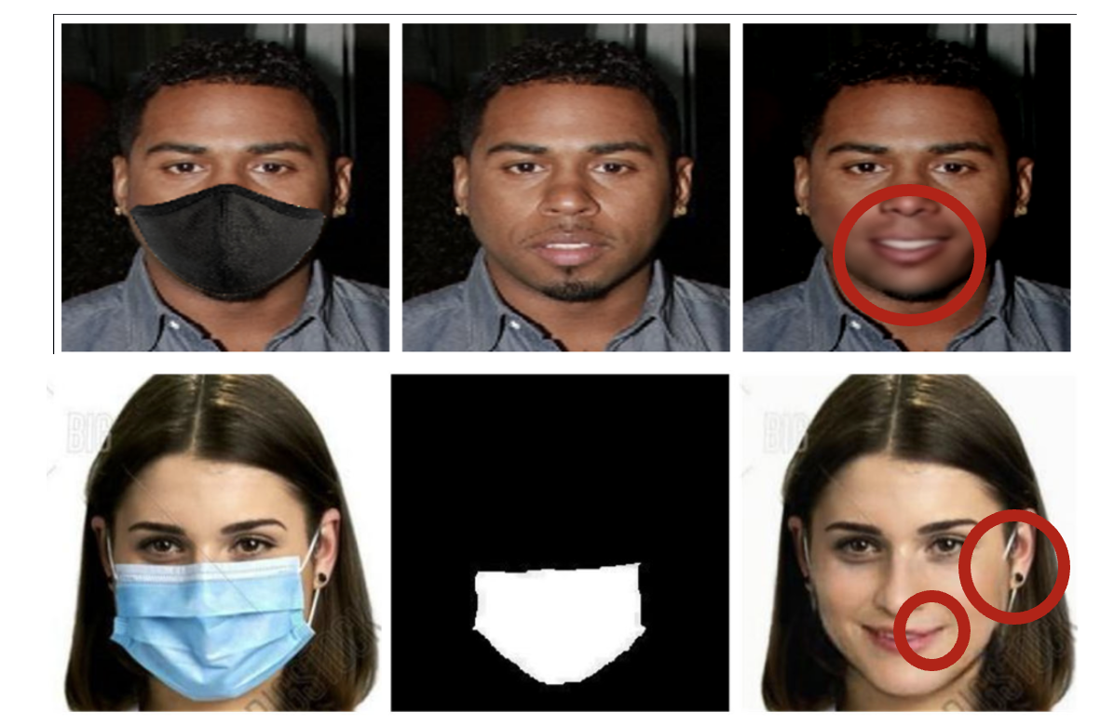
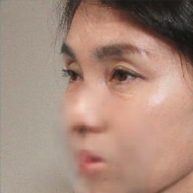
Introduction
Previous methods of mask removal – low and unusable quality
Inaccurate identity information
Artifacts that degrade quality
Low quality generation

Slide 5
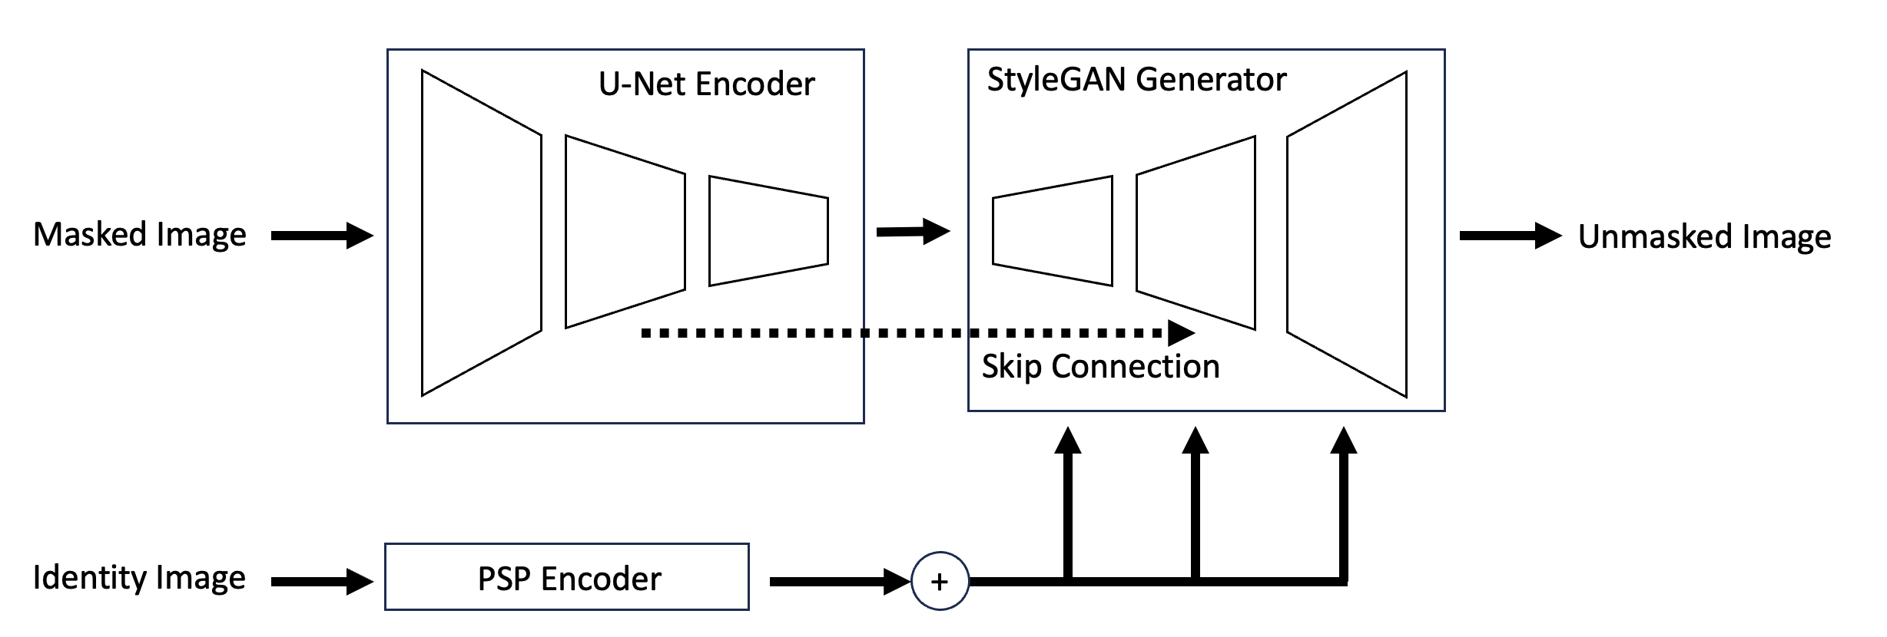
Method
We propose a novel neural network architecture to solve this task.

Slide 6
Method
Features of the masked image are preserved using the U-Net encoder
Identity features are encoded by the PSP encoder and used as style vectors.
The final image is generated by a StyleGAN generator

Slide 7
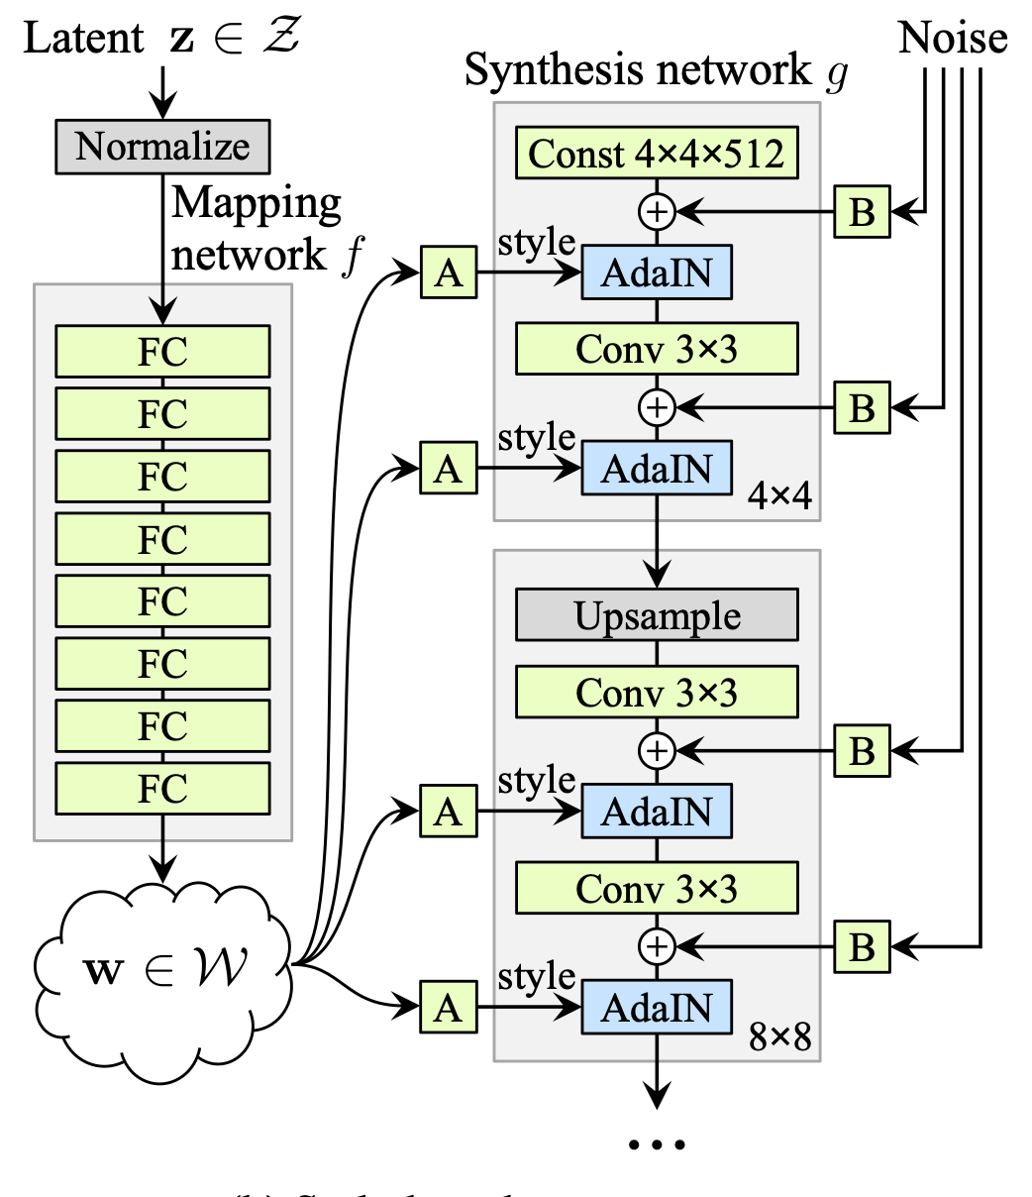
Method
StyleGAN Generator (CVPR ‘19)
Generate image starting from a fixed constant.
Mapped latent vectors are used as style vectors.
Single channel random noise input is used for generating stochastic detail.
Can generate highly realistic and diverse images with controllable style.

Slide 8
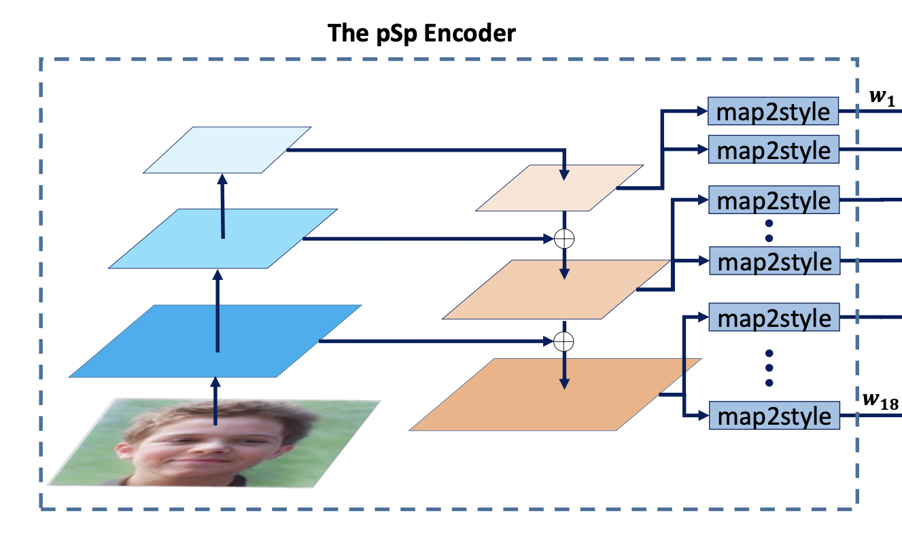
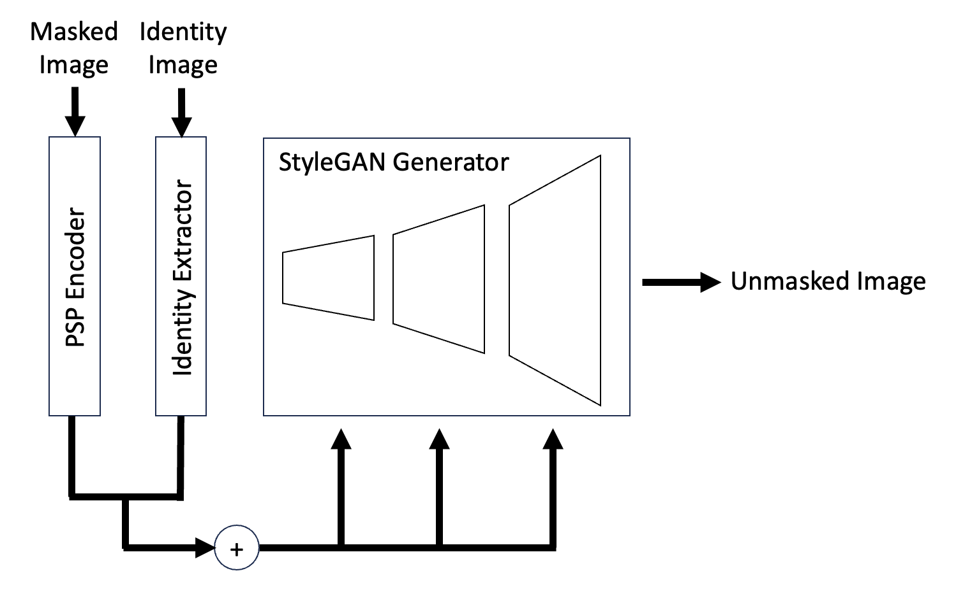
Method
Pixel2Style2Pixel Encoder (CVPR ‘21)
Method of using StyleGAN generator for image-to-image translation.
Generates style vectors that form the latent space of the StyleGAN generator.
Initial approach to our task
Starting from the initial constant, the PSP encoded features and extracted identity features are added and used as the style vectors.

Slide 9
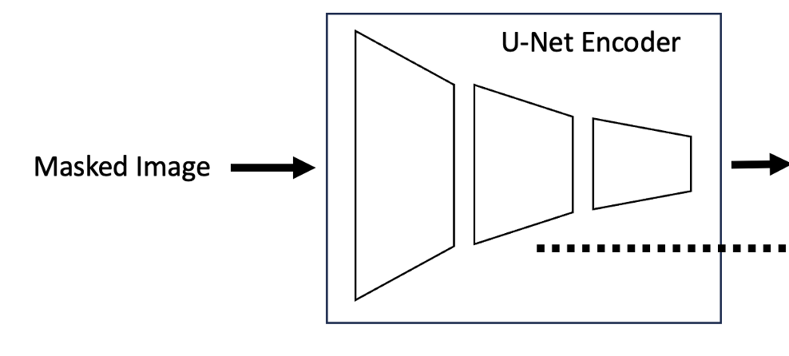
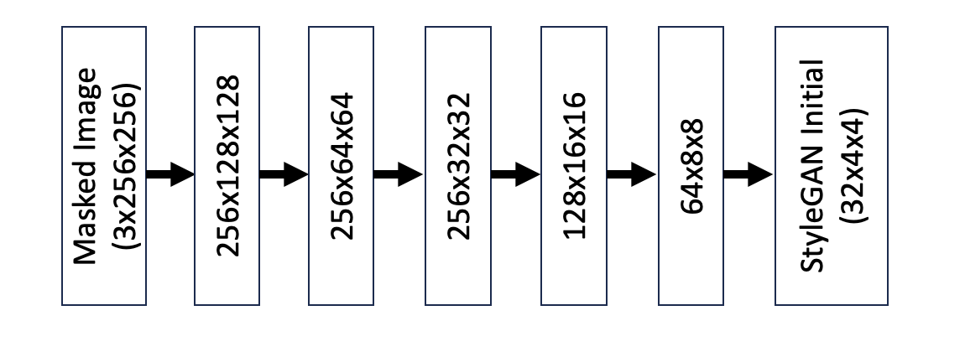
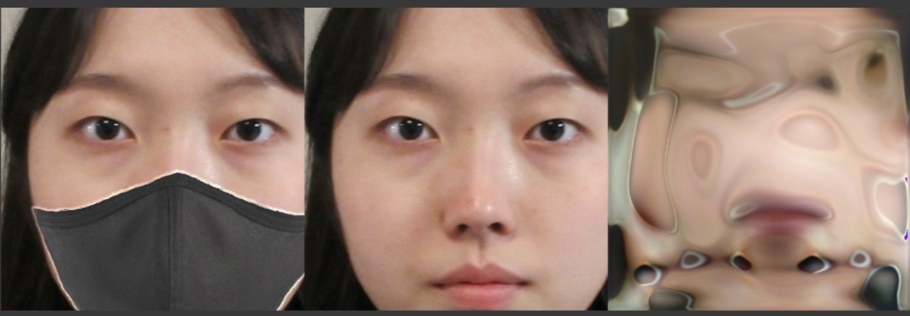
Method
U-Net Encoder
We need to extract conditions from two images, therefore need a new architecture.
We use a U-Net based encoder to extract the features of the masked image.
This is necessary to preserve information outside the face of the original image.
Detailed structure of U-Net encoder
Image generated without U-Net encoder
The PSP framework is not enough to generate meaningful images from the given inputs.

Slide 10
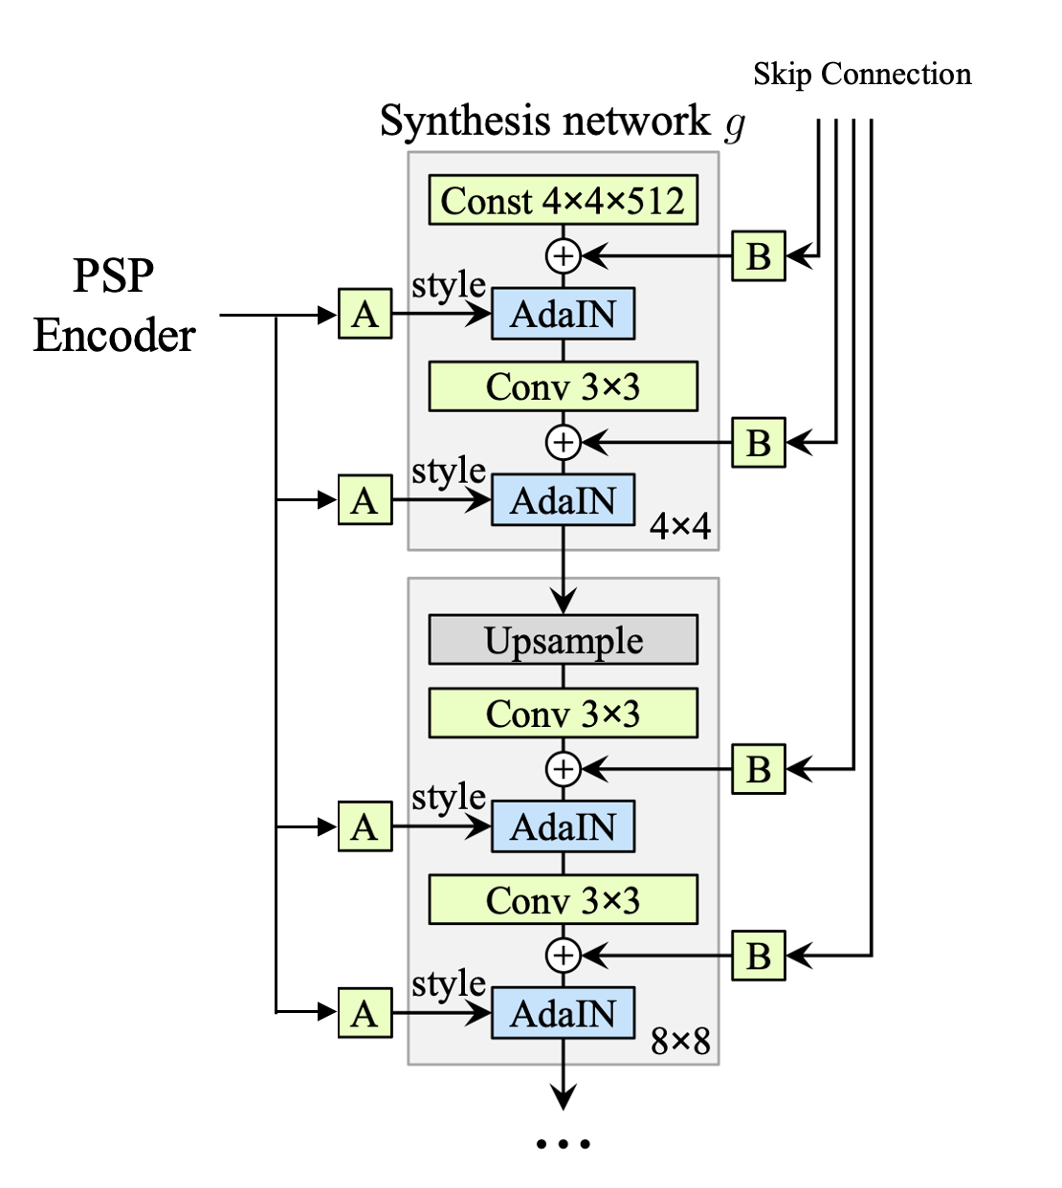
Method
Downsampled
Masked Image
Our Modified StyleGAN Generator
Start with the down-sampled 4x4 masked image.
Output of the PSP encoder is used as style vector (A).
Skip connections from U-Net encoder is inserted (B).
The network learns the channel-wise percentage of how much the identity features should be considered.

Slide 11
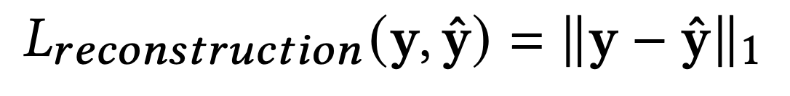
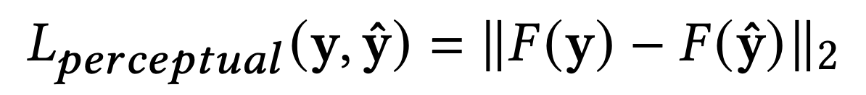
Method
Objective Function
Reconstruction Loss: L1 loss between the ground truth and the generated image.
Perceptual Loss: LPIPS loss between the ground truth and the generated image.
Identity Loss: Cosine similarity between identity features (output of pretrained network).
GAN Loss: Vanilla GAN loss, we use the PatchGAN discriminator.
Total Loss: Sum of all losses above with weights of (50, 5, 1, 3) respectively.

Slide 12
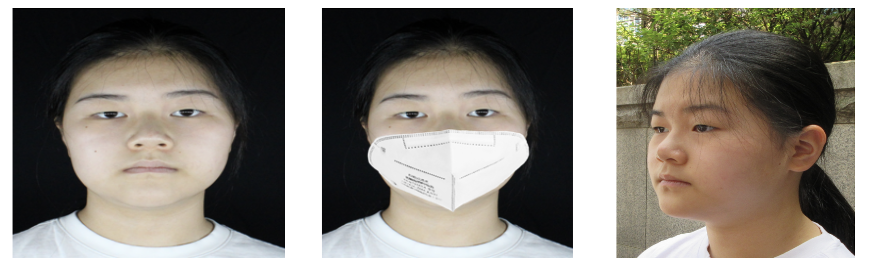
Experiment
Dataset
We require a ground truth image for each masked image of the same pose.
This is impossible to acquire, we choose to use a synthetic dataset.
Final dataset (From <Face image data with known family relationship, AI-Hub>)
Data Example
From left to right: Ground Truth, Masked Image, Identity Image
 | Ground Truth & Masked Image Pair | Identity Image | Identity Image Number of People | Ratio
Train | 6943 | 25235 | 2195 | 0.8
Validation | 896 | 3215 | 278 | 0.1
Test | 907 | 3154 | 272 | 0.1

Slide 13
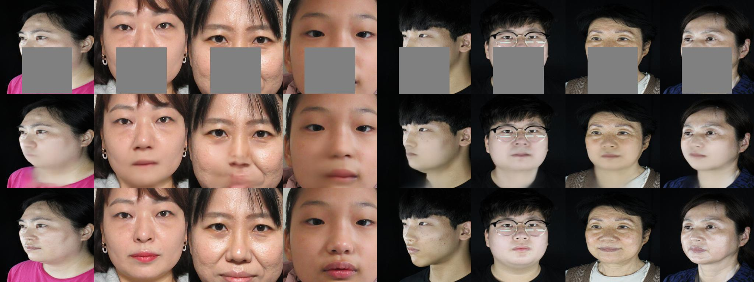
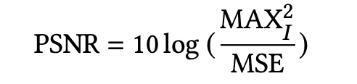
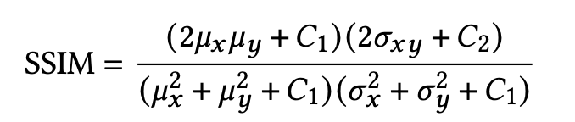
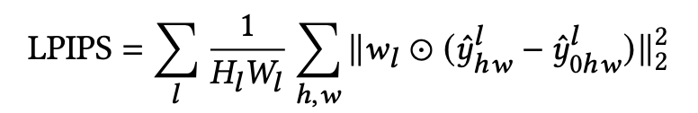
Experiment
Baseline Model: DMFN (Dense Multi-scale Fusion Network)
An image inpainting model, chosen due to the lack of open-source code.
The model consists of dense combinations of dilated convolution operations.
We train the model on our dataset to generate the lower half of the image.
Evaluation Metrics: PSNR, SSIM, LPIPS

Slide 14
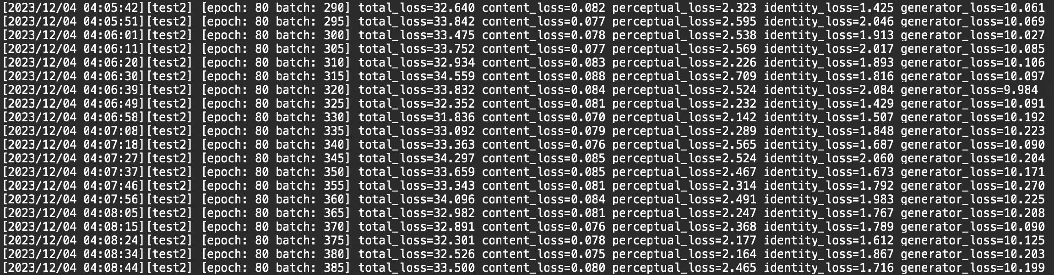
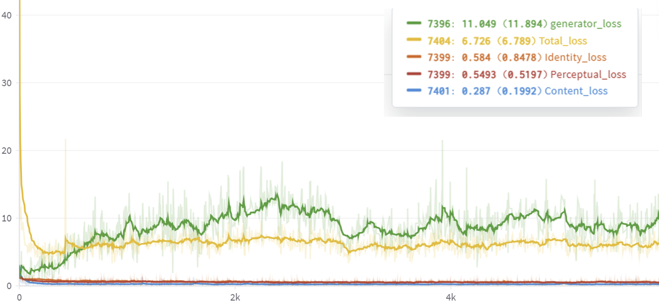
Experiment
Training
Trained with a single V100 GPU.
1 epoch takes 30 minutes with batch size 8.
Early stopping used with validation set, total of 87 epochs trained.
Used Adam optimizer for both generator and discriminator.

Slide 15
Experiment
 | PSNR (↑) | SSIM (↑) | LPIPS (↓) | Execution Time (per image) Model Size
Baseline Model (DMFN) | 26.92 | 0.90 | 0.03 | 1403 ms 111 MB
UnVeilify (No U-Net Encoder) | 3.42 | 0.00 | 0.91 | 55.65 ms 770 MB
UnVeilify (No Identity Image Given) | 6.57 | 0.01 | 0.89 | 55.65 ms 770 MB
UnVeilify (Unnormalized Identity Features) | 19.16 | 0.75 | 0.14 | 55.65 ms 770 MB
UnVeilify (Final Model) | 27.04 | 0.84 | 0.06

Slide 16
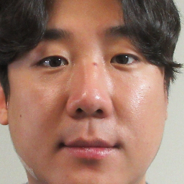
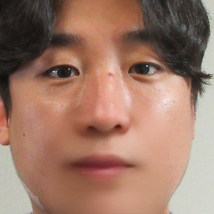
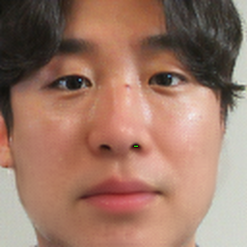
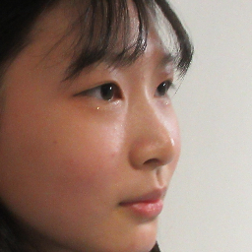
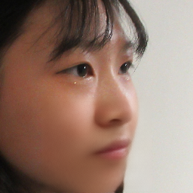

Experiment
Ground Truth
Baseline (DMFN)
Our Model (UnVeilify)
Image Results (Test Set)
Higher quality image generation.
Reduced blurriness of face.
Relatively similar identity features.

Slide 17
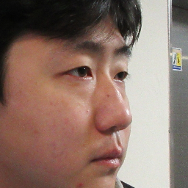
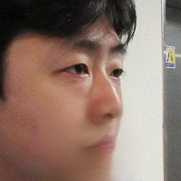
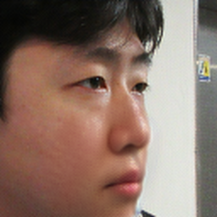
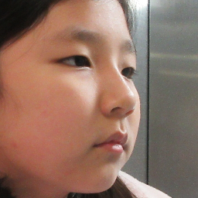
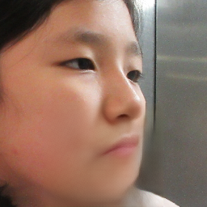
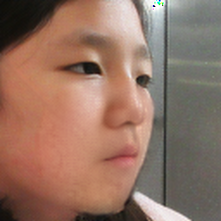
Experiment
Ground Truth
Baseline (DMFN)
Our Model (UnVeilify)
Image Results (Test Set)
Generation more robust to pose.
Reduced blurriness of surroundings.
Relatively similar identity features.

Slide 18
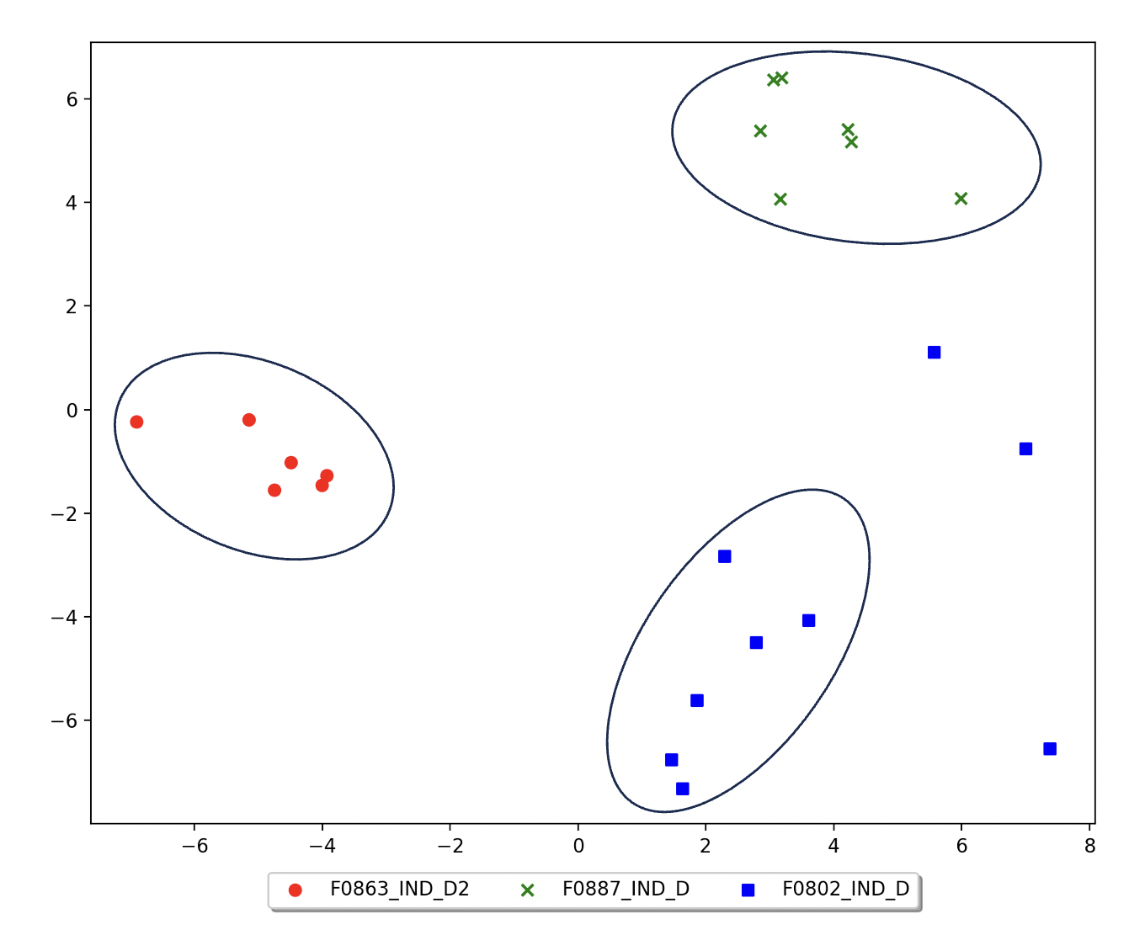
Experiment
Identity extraction visualization
The extracted features are highly separable and clustered well.
This is due to the strong identity extraction of the PSP encoder.
t-SNE embeddings of random 3 identities from the test set.

Slide 19
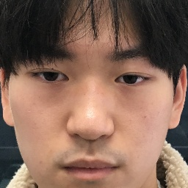
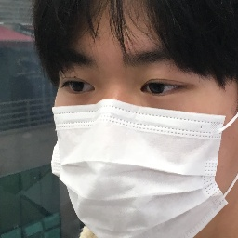
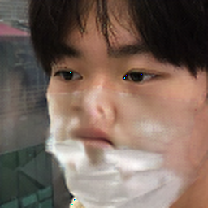
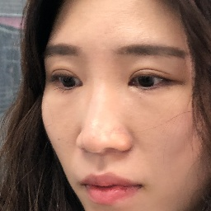
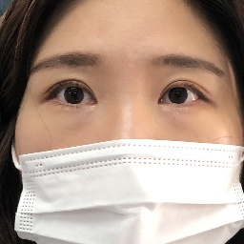
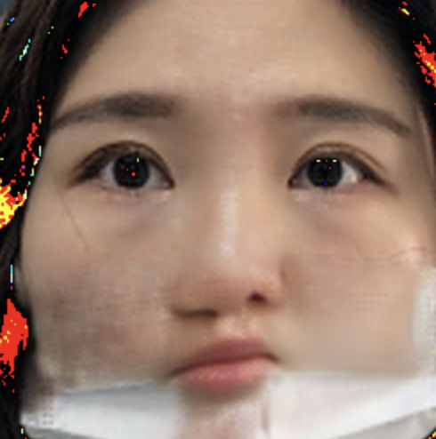
Experiment
Identity Image
Masked Image
Generated Output
Real World Image Results
Unusable quality.
Model has never seen real-world data.
Therefore, cannot process actual face masks.

Slide 20
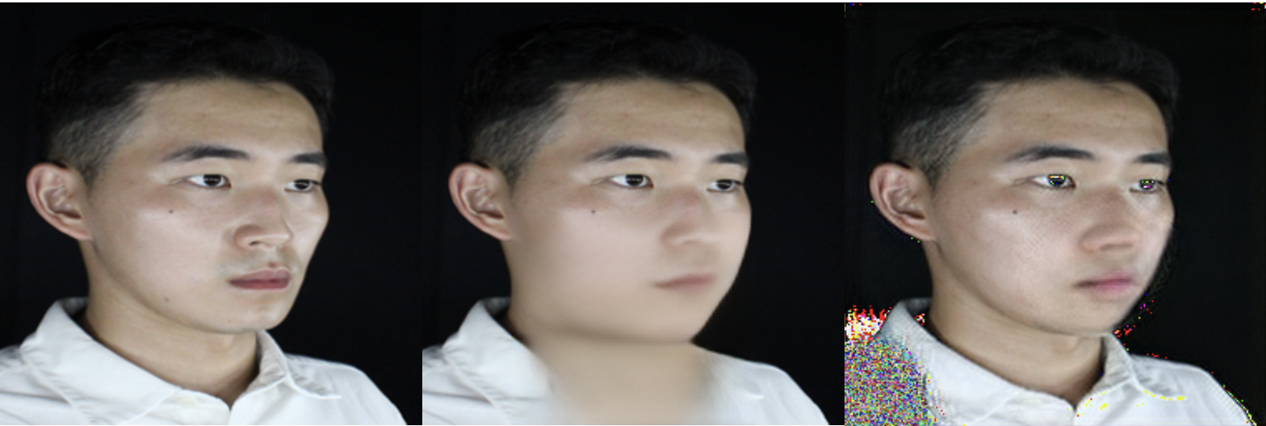
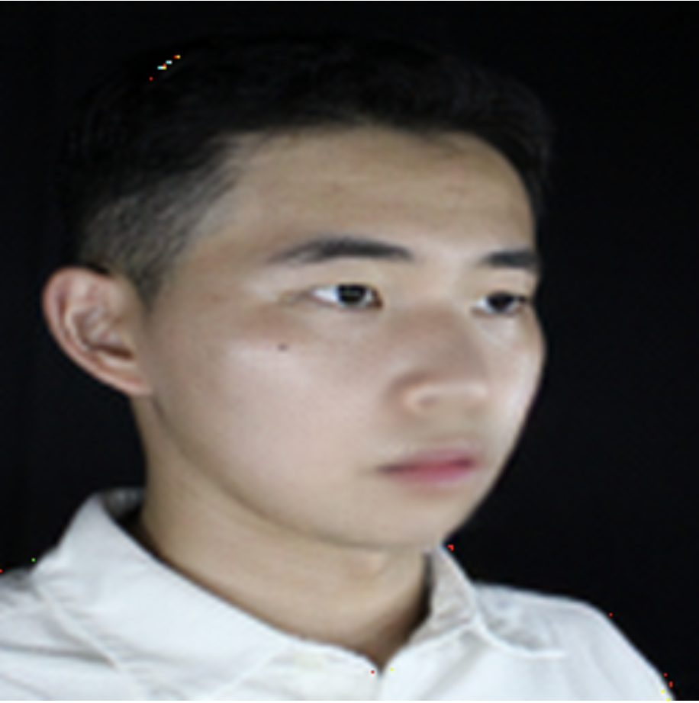
Discussion
Limitations
Certain cases show generated outputs containing noise-like artifacts.
This was partly solved with normalized identity features, but problem still exists.
Blurry results and under-represented facial attributes.
Due to the high L1 loss, however the model can’t learn to generate without high L1 loss.
Our model is not generalizable to real-world datasets.
Due to the model learning from synthetic data (highly different from real-world data).
UnVeilify
(Unnormalized Identity Features)
UnVeilify
(Final Model)
Ground Truth

Slide 21
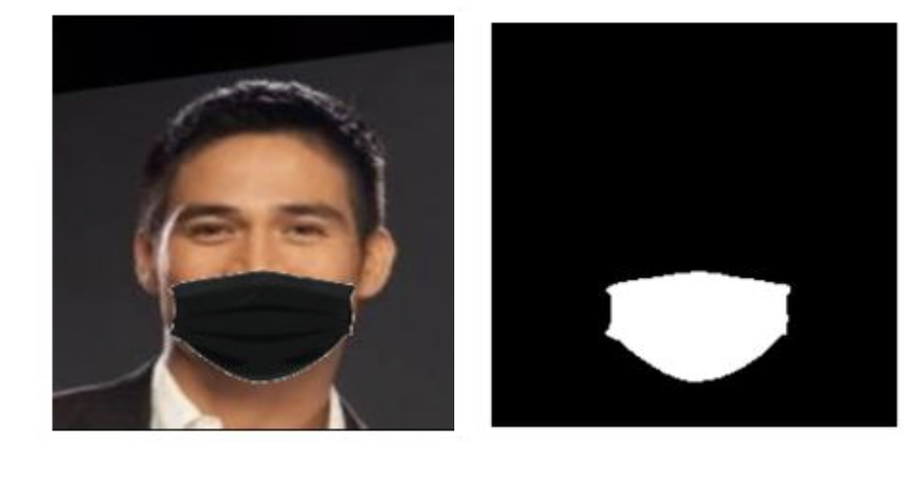
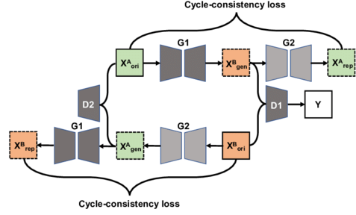
Discussion
Further improvements
Using binary segmented mask information will help guide the model.
Having the mask generation process be inside the network architecture could help with generalizing to real world applications.
Using a more diverse and realistic dataset may also help with generalizability.
By encoding additional information (e.g., emotion), we may obtain higher quality.
Binary mask segmentation
Architecture of CycleGAN, consistency loss can be used for masked image generation

Slide 22
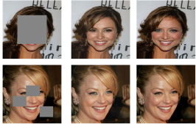
Discussion
Further Research
We believe our work is not limited to mask removal, but rather can be extended to other inpainting / reconstruction tasks.
We believe our novel network architecture may be expanded to personalized conditional image generation.
Example of facial inpainting task

Slide 23
Conclusion
Accomplishments
Introduced a novel network architecture for personalized image-to-image translation.
Generation of quality results even in extreme pose conditions.
Highly accurate inference on the representation of identity features.
Network is fast, making it applicable to real-world scenarios.

Slide 24
감사합니다.
Code: https://github.com/jinhyoungjoo/UnVeilify

